Slide 1
Setting up Interactive Notebook for Term 2
Cover page- Linear relationships
Contents page x 2
Glossary x2
Rule up Cornell notes taking for 4 lessons

Slide 2
Linear relationships
EQ – How do I sketch a linear graph using different forms of a linear equation?
Mrs James
Year 10

Slide 3
24
7
30
Date
Linear relationships
EQ – How do I sketch a linear graph using different forms of a linear equation?
A linear graph has an equation that can be written in the standard form y = mx + c, where m is the gradient of the line, and c is the y-intercept.
The gradient (or slope) is a measure of the steepness of a graph.
If the gradient, m, of the line is positive, the graph will have an upward slope to the right.
If the gradient, m, of the line is negative, the graph will have a downward slope to the right.
The greater the magnitude of the gradient, the steeper the linear graph will be.
Notes:
Input

Slide 4
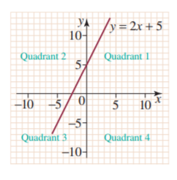
Remember, read and have a class discussion on the following…
A linear graph is drawn on a Cartesian plane, with two axes (x and y) meeting at the origin (0, 0).
The axes divide the plane into four regions, or quadrants.
A point is specified by its x- and y-coordinates.
A graph of the line y = 2x + 5 is shown in the figure at right.
One method which can be used to draw a graph of an equation is to simply plot the points on graph paper.
The points can be plotted manually, or a graphing calculator can be used to plot the points.

Slide 5


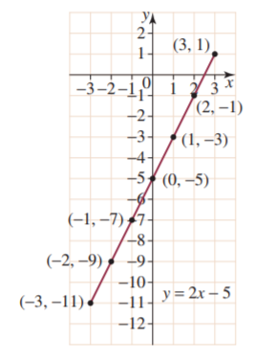
Example 1: We will do this together. Complete this in your Interactive notebook
Tips to help you:
Create a table of values using the given x-values.
2. Find the corresponding y-values by substituting each x-value into the rule.
3.Plot the points on a Cartesian plane and rule a straight line through them. A minimum of two points are necessary to plot and sketch a straight line.
Plot the linear graph defined by the rule y = 2x - 5 for the x-values -3, -2, -1, 0, 1, 2, 3.

Slide 6
24
7
30
Date
Linear relationships
EQ – How do I sketch a linear graph using different forms of a linear equation?
Two methods can be used to plot a straight line:
Method 1: The x- and y-intercept method.
Method 2: The gradient–intercept method.
Sketching a straight line using the x- and y-intercept method
As the name implies, this method involves finding the x- and y-intercepts, then joining them to sketch the straight line.
If the equation is in the form y = mx + c, the value of c gives the y-intercept.
Notes:
Input

Slide 7
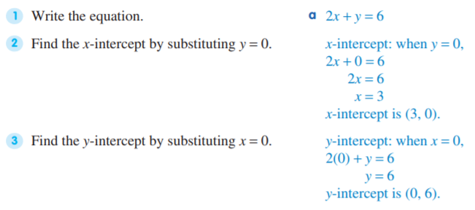
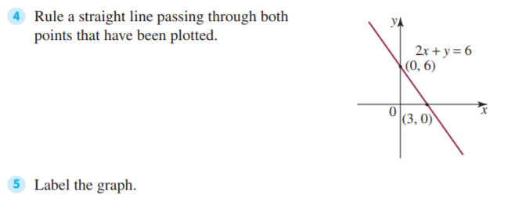
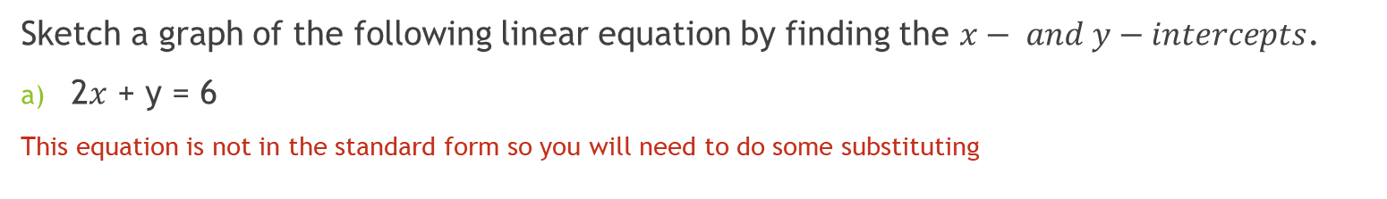
Example 2: We will do this together. Complete this in your Interactive notebook
Sketch a graph of the following linear equation by finding the $x− and y−intercepts$.
2$x$ + y = 6
This equation is not in the standard form so you will need to do some substituting

Slide 8
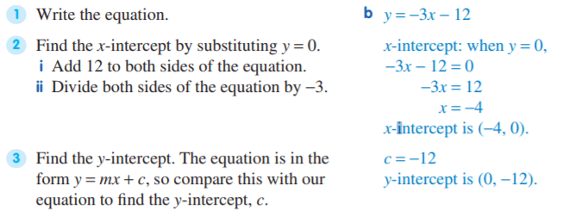
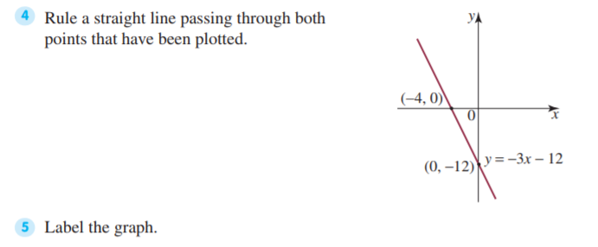

Example 3: This is where you will need to work independently. GIVE YOUR 100%
Sketch a graph of the following linear equation by finding the x- and y-intercepts.
y = -3$x$ – 12
The equation is in the form $y = mx + c$, so compare this with the equation above to find the y-intercept, c.

Slide 9
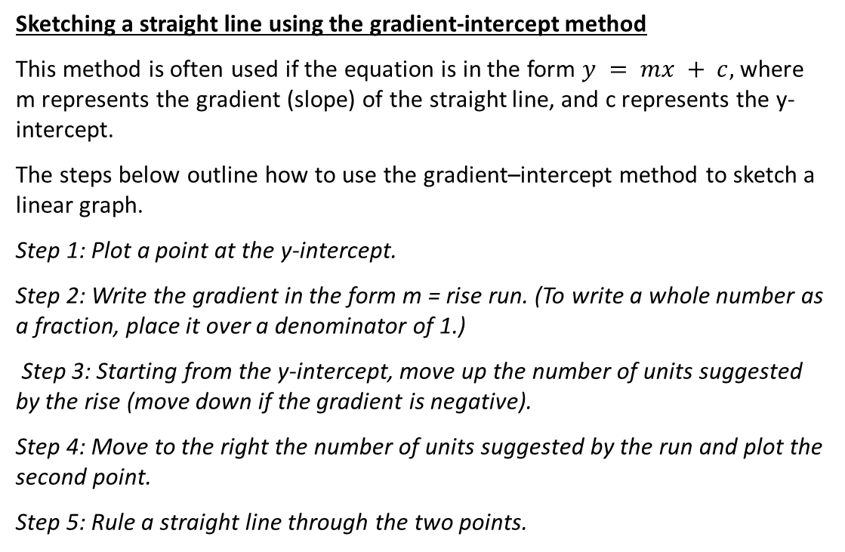
24
7
30
Date
Linear relationships
EQ – How do I sketch a linear graph using different forms of a linear equation?
Sketching a straight line using the gradient-intercept method
This method is often used if the equation is in the form $y = mx + c,$where m represents the gradient (slope) of the straight line, and c represents the y-intercept.
The steps below outline how to use the gradient–intercept method to sketch a linear graph.
Step 1: Plot a point at the y-intercept.
Step 2: Write the gradient in the form m = rise run. (To write a whole number as a fraction, place it over a denominator of 1.)
Step 3: Starting from the y-intercept, move up the number of units suggested by the rise (move down if the gradient is negative).
Step 4: Move to the right the number of units suggested by the run and plot the second point.
Step 5: Rule a straight line through the two points.
Notes:
Input

Slide 10
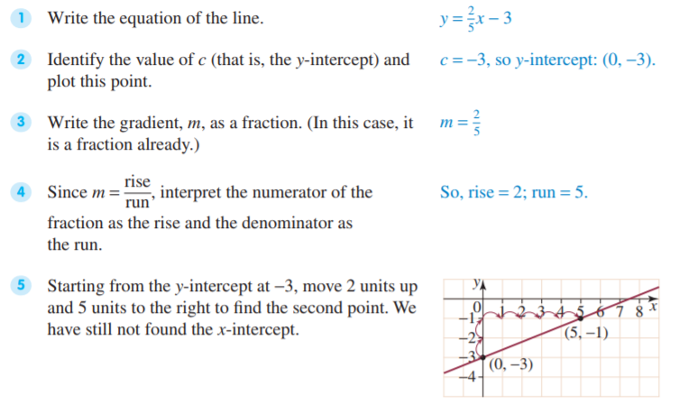
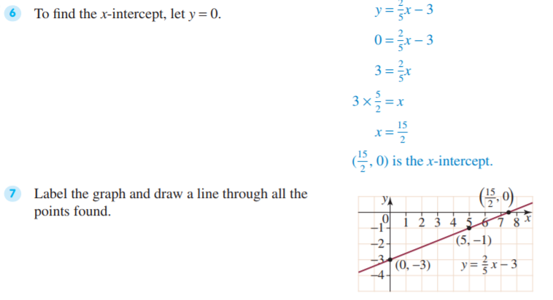

Example 4: We will do this together. Complete this in your Interactive notebook
Plot the graph of y = $\frac{2}{5}x$ - 3 using the gradient-intercept method.

Slide 11
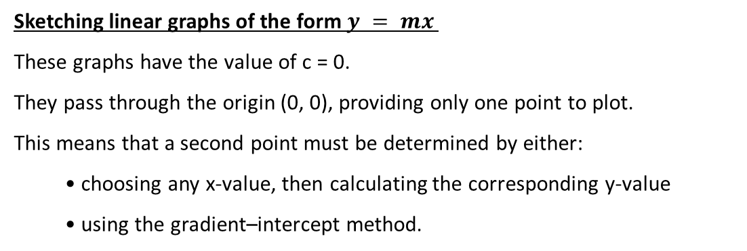
24
7
30
Date
Linear relationships
EQ – How do I sketch a linear graph using different forms of a linear equation?
Sketching linear graphs of the form $y = mx$
These graphs have the value of c = 0.
They pass through the origin (0, 0), providing only one point to plot.
This means that a second point must be determined by either:
• choosing any x-value, then calculating the corresponding y-value
• using the gradient–intercept method.
Notes:
Input

Slide 12
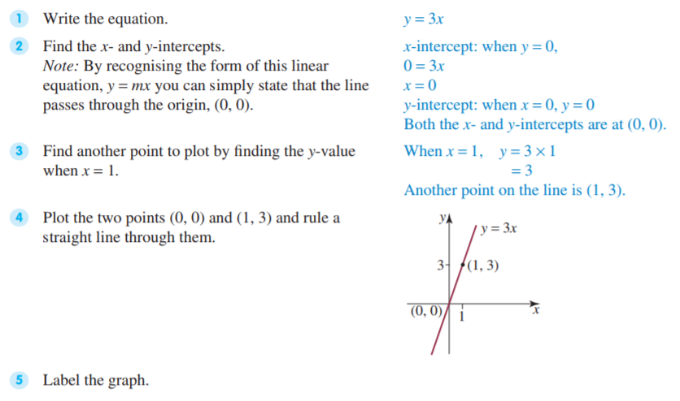

Example 5: We will do this together. Complete this in your Interactive notebook
Sketch the graph of y = 3$x$

Slide 13
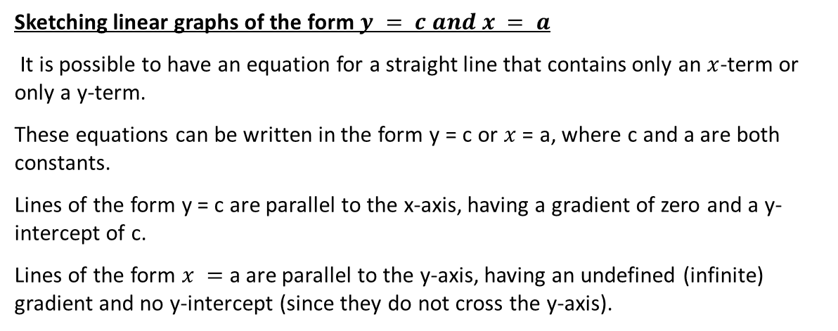
24
7
30
Date
Linear relationships
EQ – How do I sketch a linear graph using different forms of a linear equation?
Sketching linear graphs of the form$y = c and x = a$
It is possible to have an equation for a straight line that contains only an $x$-term or only a y-term.
These equations can be written in the form y = c or $x$ = a, where c and a are both constants.
Lines of the form y = c are parallel to the x-axis, having a gradient of zero and a y-intercept of c.
Lines of the form $x =$a are parallel to the y-axis, having an undefined (infinite) gradient and no y-intercept (since they do not cross the y-axis).
Notes:
Input

Slide 14
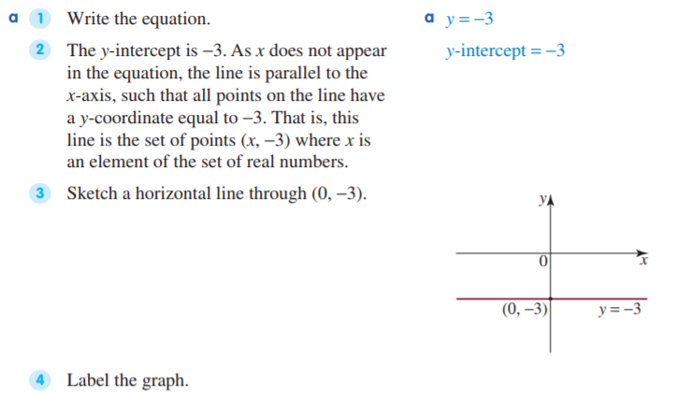
Example 6: We will do this together. Complete this in your Interactive notebook
Sketch graphs of the following linear equations. a) y = -3 b) x = 4

Slide 15
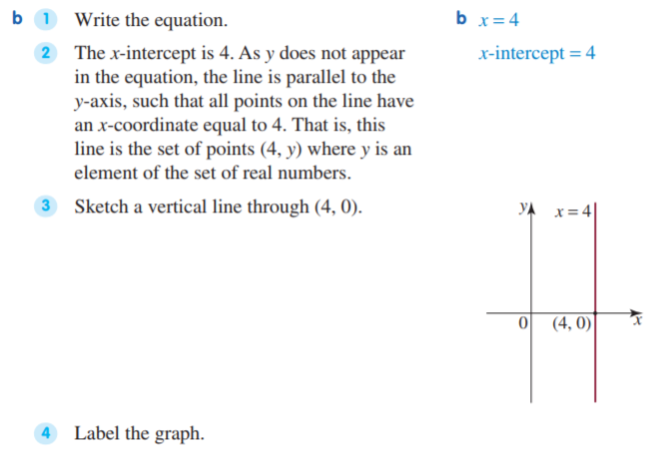

Slide 16
Your turn to practice
Complete the following worksheets:
Sketching linear graphs worksheet 1 (easiest)
Graphs of linear equations worksheet 2 (moderate)
More graphs of linear equations worksheet 3 (challenging)
These worksheets will be on CONNECT along with this PowerPoint to support your revision and study of this topic.
Homework/Revision
Continue to work through the worksheets above
Write your summary of this topic, ensuring you can sketch all the graphs covered in these class notes

